Slide 1
Big Mountain Resort Executive Presentation
Jacob Javier

Slide 2

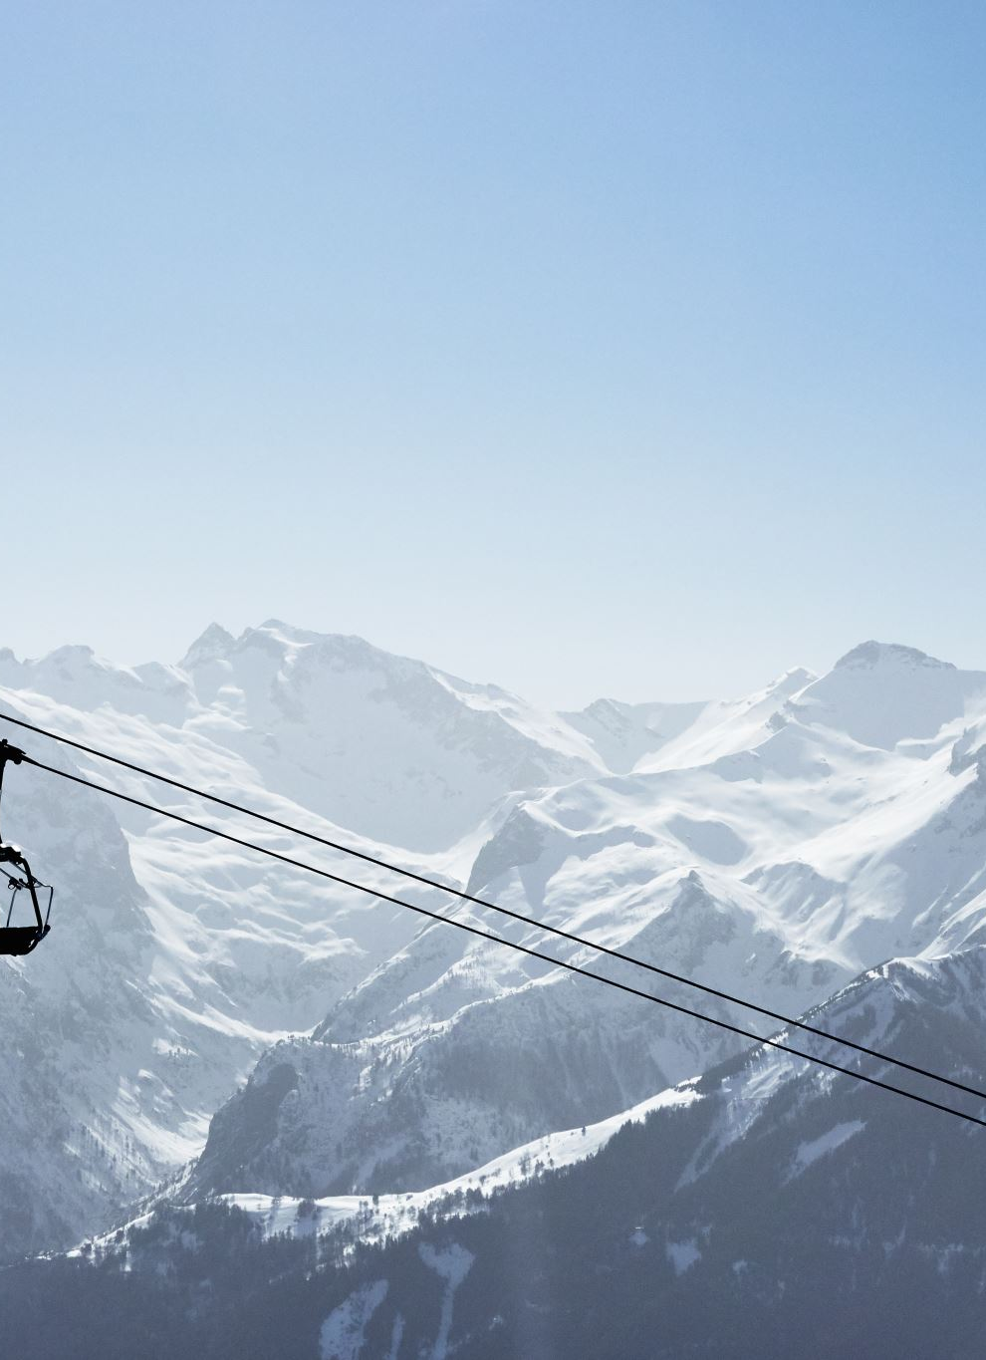
Problem Identification
Big Mountain Resort needs a revaluation of their ticket prices before the start of the next season.
Big Mountain Resort is a ski resort in Montana that overlooks Glacier National Park and Flathead National Forest.
They just installed a new chair lift that increases their operating costs by $1,540,000.
The board is also considering changes that need to be evaluated with the new ticket pricings.

Slide 3
Recommendation and key findings
For the facilities that they provide, Big Mountain should increase their ticket prices to about $95.87 (± $10.39).
$3,474,638 of additional revenue could be generated with additional changes that justify a $1.99 ticket price increase.
Adding a run that extends down by 150 feet
Adding a new chair lift

Slide 4
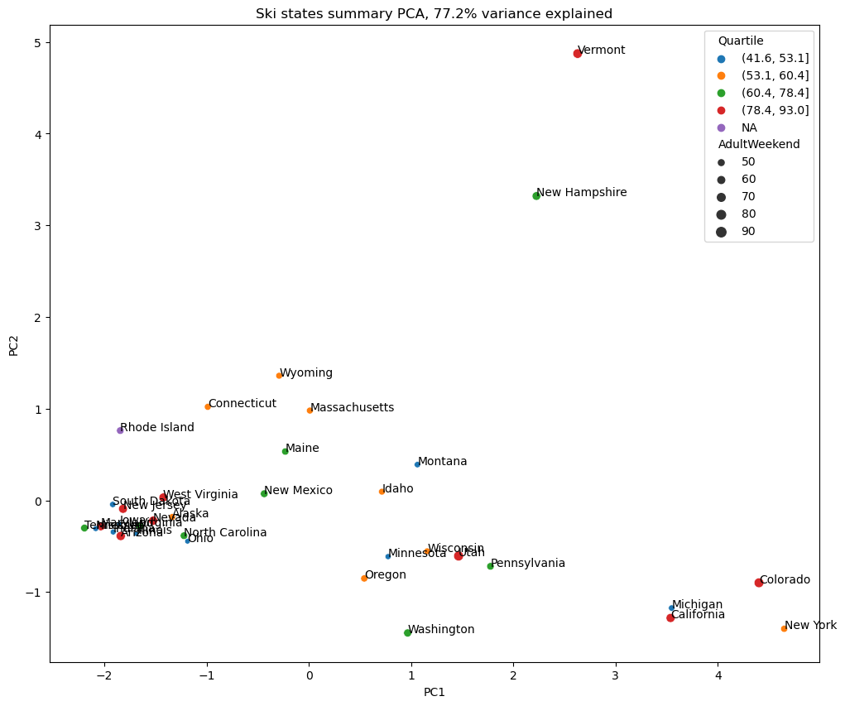
Model Analysis: EDA
16% of the 330 resorts were ignored due to insufficient relevant data.
Primarily no pricing data
Geographical data was ignored for this model since evaluating states separately accounted for 77% model variance.

Slide 5
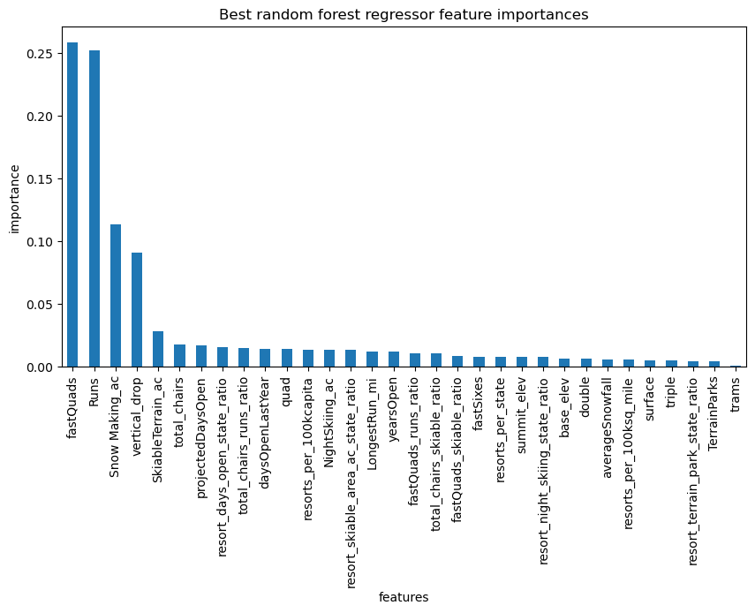
Model Analysis: Model Testing
A random forest regressor model was selected since its mean absolute error ($9.54) was about $1 less variable than a linear regression model.
The key factors contributing to ticket pricing were:
Longest vertical drop
Number of runs
Area covered by artificial snow
Number of fast quads

Slide 6
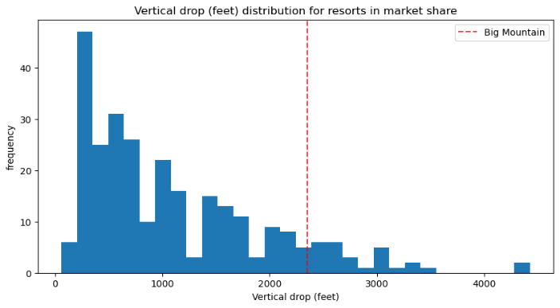
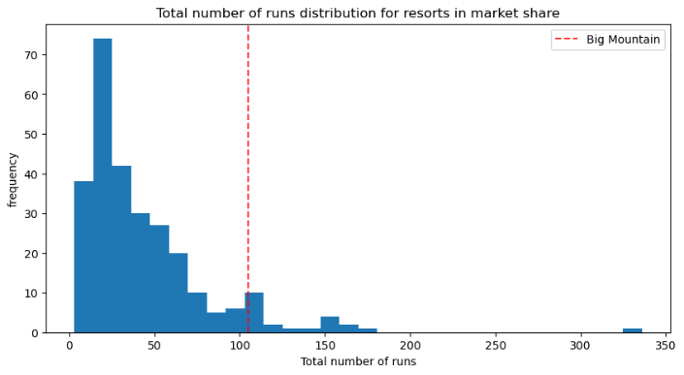
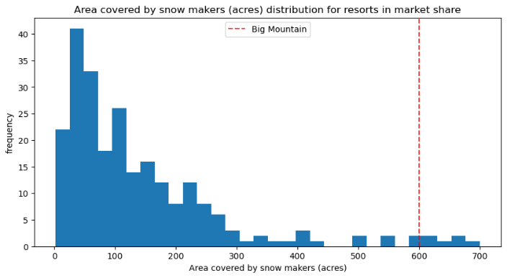
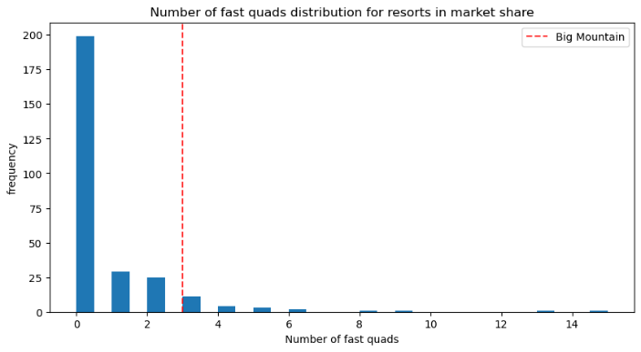
Model Analysis: Big Mountain Resort
Big Mountain Resort could charge between $85.48 and $106.26.
Top 11% highest vertical drop
Top 7% in number of runs
Top 3% in acres of artificial snow
Top 7% in fast quads available

Slide 7
Summary and conclusion
Big Mountain has the potential to increase its revenue by adjusting its prices within a more competitive range that could cover the $1.5 million of new operation costs.
Visitors are looking to consistently enjoy a variety of slopes during their ski trips.
Developing higher run and lifts that can accommodate larger groups may be profitably desired by the visitors

